Slide 1
Multilingual Presentation
Dr. Heather Ireland
February 2023

Slide 2
agenda
WIDA Rollout Plan 3
Testimonial 6
Areas of Focus 7
WIDA Rollout Year 2 8

Slide 3
WIDA Rollout Plan
Year 1 2022-2023

Slide 4
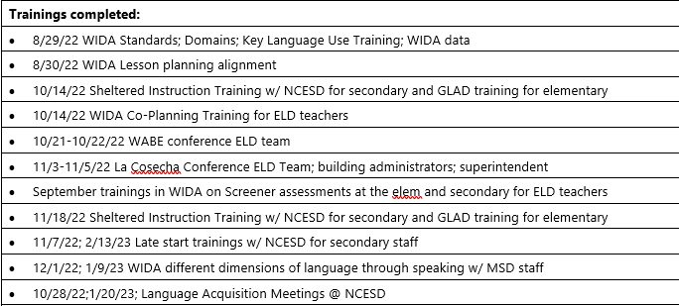
WIDA Rollout Plan
Year 1 2022-2023

Slide 5
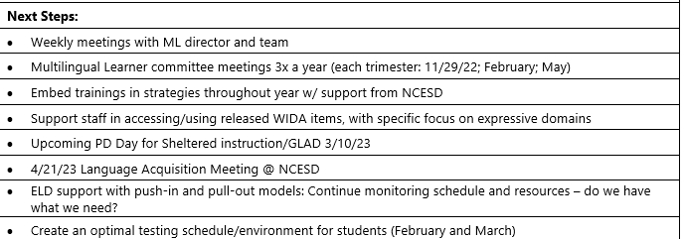
WIDA Rollout Plan
Year 1 2022-2023

Slide 6
Testimonial

Slide 7
areas of focus: year 1
District focus on learning WIDA Standards & Framework
Embedded, ongoing training on dimensions of language through speaking (expressive domain)
Monitoring data & providing interventions
Using strategies learned through professional development
ELD supports in small groups, in classrooms, co-planning
Identifying instructional material needs

Slide 8
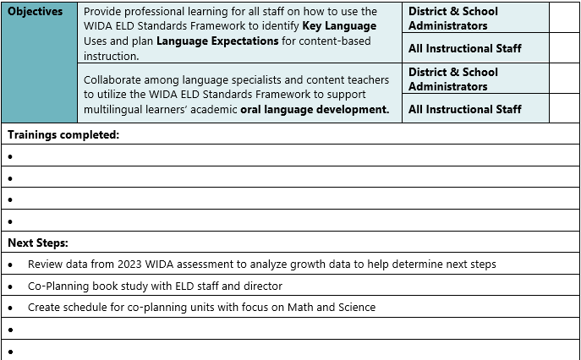
WIDA Rollout Plan
Year 2 2023-2024

Slide 9
thank you

